Slide 1


Test Performance Dashboard Proposal
Version: 1.0

Slide 2
Team Member
Team member
Đặng Thị Thảo My
Bùi Nguyễn Thiện Khánh
Nguyễn Anh Quân
Lê Huỳnh Anh Tuấn

Slide 3
General Information
Supervisor’s information: Mr. Trương Phước Lộc.
Client’s information:
Contact Person: Mr. Tô Hòa Duy Mẫn (Project Manager).
Company: Robert Bosch Engineering Vietnam.
Address: G Floor, E-town building, 34 Cong Hoa, Tan Binh, HCM.
Phone:

Slide 4
About Our Team:
A merged group of four students tackling a challenging task in developing a Platform-as-a-Service solution for BOSCH Engineering and Business Solution Co. Ltd company in Vietnam.
The Robert Bosch Performance Test Dashboard project is a 9-months project sponsored by Robert Bosch Engineering and Business Solution Viet Nam (Bosch). Participants include lecturers from Auckland University of Technology (AUT) and Ho Chi Minh University of Science (HMCUS), technical experts from Bosch and a group of four students.

Slide 6
Project Description:
Performance test dashboard is a Web Application Server and a Client Agent. The end customers are the Testing Team at BOSCH. The products will provide convenience services for BOSCH Testers and the application will run locally only in BOSCH.
This product will support :
Remote execution performance Test Script, Tracking and comparison performance result & Analytics performance report
Manage performance test script as well as report generation.

Slide 7






Technologies:
Use latest technologies.
Front-end side:
HTML5/CSS3/Javascript.
Bootstrap, AngularJs 2.
Back-end side:
Spring framework.
Hibernate.
Jmeter API.
Environment:
Cloud computing.

Slide 8
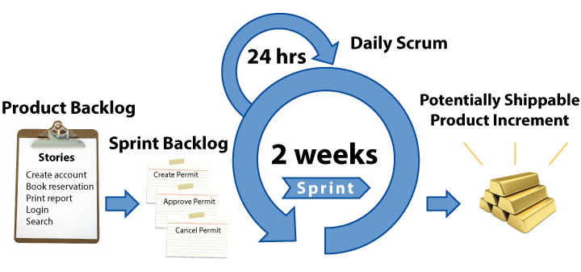
Methodology (Scrum):
Agile Process.
Sprint: 2 weeks.
Full stack (Role rotation: Analyze, Design, Code, Test + review).
Team Foundation Server (TFS).
Daily meeting at 8am at Bosch Office.

Slide 9
Objective:
New platform must have basic functions like the Jmeter software.
- Performance test.
- Load Test.
- Stress Test.
Dashboard must be user-friendly and easy to use with meaningful and reliable information, user guidance.
Provide Real-time reporting, accurate and comprehensive analytics, statistic.
Notes:
Name : đặt tên cho ThreadGroup ( ở đây mình đặt JmeterUser ).
Number of Threads(users) : số lượng người dùng mà ta muốn mô phỏng.
Ramp-up Period (in seconds): Cho biết thời gian để JMeter tạo ra tất cả những thread cần thiết.
Server name or Ip : điền địa chỉ trang web cần truy cập.
Xem kết quả của kịch bản test

Slide 10
Risks:
Schedule risk.
Scope.
Security Policies.
Notes:
Schedule: Working full time… have to balance between working hours and documenting hours.
Confliction between school schedule and working hours.
Scope: increasing from create dashboard for single test application to automation test application.
Security: Bosch apply ISO and CMNi level 3 standard so they have lots of policies and not allow us to bring the products out of Bosch

